Slide 1
bike sharing demand PREDICTION in urban centers based on weather AND TIME
KWOBA FREDRICK
05/11/2023

Slide 2

Outline
Executive Summary
Introduction
Methodology
Results
Conclusion
Appendix

Slide 3

Executive Summary
Project Objective
Methodology
Key Findings
Implications
Conclusion

Slide 4
Executive Summary
Project Objective
Predicting bike sharing demand in urban center based on weather
Methodology
Data Collection: Gathered comprehensive data on weather, demographics, and historical bike usage.
Engineered key variables that is weather and date/time predictors for robust predictive modeling.
Employed ensemble techniques for accurate demand forecasts, these included regularization, polynomial and interaction terms.

Slide 5
Executive Summary
Key Findings
Bike sharing demand is high in summer then autumn, spring and finally winter
Bike sharing demand is high in the evening hours, the hour with the highest number of bike rented being ‘18’
Implications
Informed Urban Mobility Planning: Insights support infrastructure development and resource allocation.
Enhanced User Experience: Anticipated demand aids in optimizing bike availability and service quality

Slide 6
Executive Summary
Conclusion
The project demonstrates the potential for data-driven insights to revolutionize urban bike-sharing services, paving the way for more efficient and sustainable transportation solutions.

Slide 7

Introduction
Objective: Analyze weather's impact on urban bike-sharing demand.
Approach: Collect, process weather and demand data, conduct exploratory data analysis, build predictive models.
Outcome: Real-time interactive dashboard showing weather and bike demand.

Slide 8
Introduction continued
Project Phases
Data Collection: Gather weather and bike-sharing data from various sources.
Exploratory Data Analysis (EDA): Uncover trends, patterns, and anomalies.
Predictive Modeling: Develop models to forecast bike-sharing demand.
Interactive Dashboard
Purpose: Provide stakeholders with real-time insights.
Features: Interactive map, current weather, estimated bike demand.

Slide 9

Methodology
Perform data collection
Perform data wrangling
Perform exploratory data analysis (EDA) using SQL and visualization
Perform predictive analysis using regression models
How to build the baseline model
How to improve the baseline model
Build a R Shiny dashboard app

Slide 10
Data collection
I was able to collect three sets of data namely :
cities_weather_forecast.csv
raw_bike_sharing_systems.csv
raw_worldcities.csv
raw_seoul_bike_sharing.csv
cities_weather_forecast.csv dataset was obtained from the OpenWeather API through HTTP requests
The data you will be connecting to provides the weather forecast for every 3 hours over the next 5 days.
raw_bike_sharing_systems.csv dataset was obtained by web scraping a Wikipedia table. It lists active bicycle-sharing systems around the world.
raw_seoul_bike_sharing.csv and raw_worldcities.csv datasets were downloaded as csv files from cloud storage
World cities dataset contains information such as name, latitude, and longitude, about major
cities around the world.
raw_seoul_bike_sharing contains weather information (Temperature, Humidity, Windspeed, Visibility,
Dewpoint, Solar radiation, Snowfall, Rainfall), and the number of bikes rented per hour and date in Seoul .

Slide 11
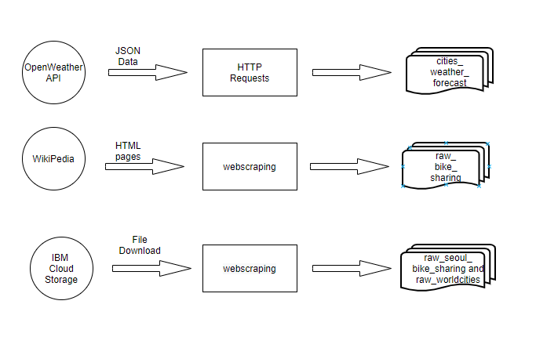
Data Collection Process Illustrations Of Different Datasets.

Slide 12
Data wrangling
Describe how data sets were processed
Detecting and handling missing values, inconsistent data, and incorrect data formats
Creating indicator(dummy) variables for categorical variables
Normalizing the data

Slide 13
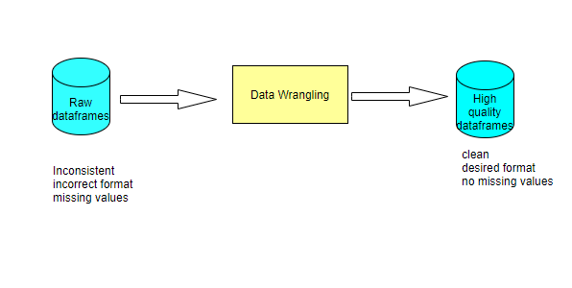
Data Wrangling Process

Slide 14
EDA with SQL
Summarize performed SQL queries using bullet points
SQL queries performed were for the following intentions
Finding valuable statistics
Filter database based on different cities
Find patterns such as seasonality and similarity

Slide 15
EDA with data visualization
Summarize what charts were plotted using bullet points
Histogram
This was to understand the distribution of data
Scatter plots
For finding correlations between important features using scatter plots
Boxplots
For spotting outliers and irregular behavior in different features of data

Slide 16
Predictive analysis
Summarize how you built, evaluated, improved and found the best performing model
I built five linear regression models by using both the Date/time variables as predictors and the bike sharing count as the response variable
I was able to evaluate these models based on their R-squared and RMSE values
These models were improved by use of polynomial and interaction terms and to reduce the complexity and curb overfitting, we implemented different regularization techniques in these models

Slide 17
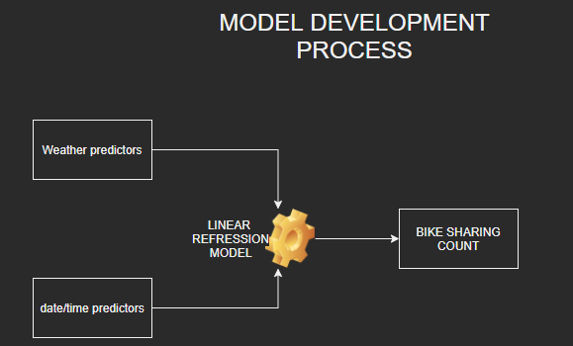
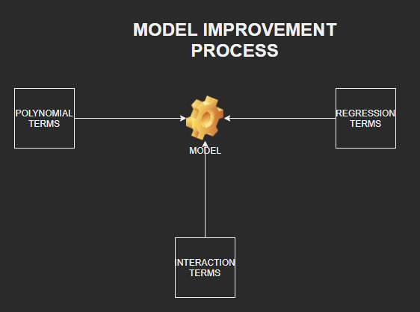
Model Development Process

Slide 18
Build a R Shiny dashboard
Summarize what plots and interactions you built into the dashboard
A static temperature trend line
An interactive bike-sharing demand prediction trend line
A static humidity and bike sharing demand prediction correlation plot

Slide 19
Results
Exploratory data analysis results
Predictive analysis results
A dashboard demo in screenshots

Slide 20
EDA with SQL
The following queries were created in this section
Busiest bike rental times
Hourly popularity and temperature by seasons
Rental Seasonality
Weather Seasonality
Bike-sharing info in Seoul
Cities similar to Seoul

Slide 21
Busiest bike rental times
19/06/2018 at 18th hour had the most bike rentals of up to 35556 bikes

Slide 22
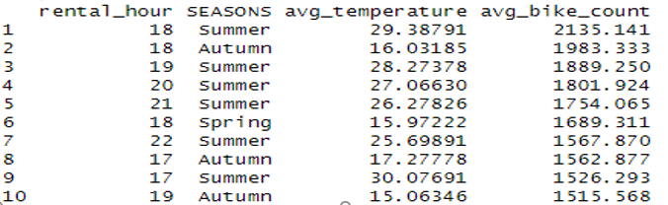
Hourly popularity and temperature by seasons
It’s observed that the 18th hour in summer has the highest average bike count and average temperature values

Slide 23
Rental Seasonality
In the proceeding slides showing rental seasonality, it is observed that summer has the highest values of average bike count

Slide 24
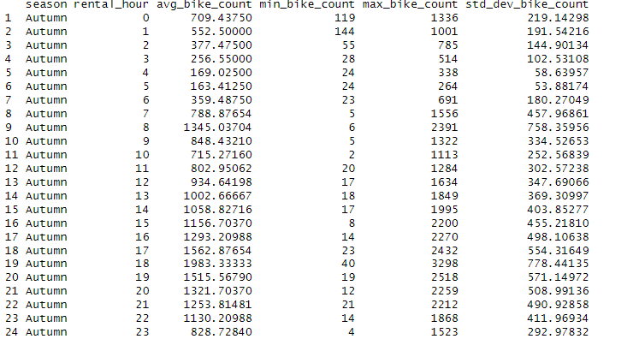
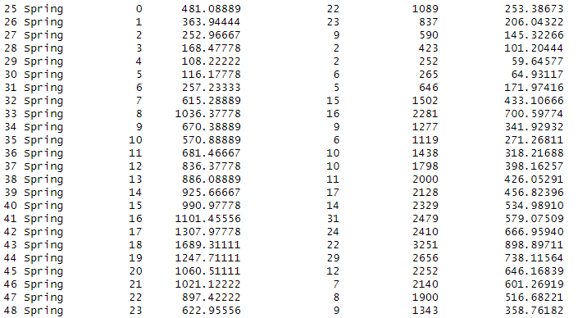
Rental seasonality for Autumn and Spring

Slide 25
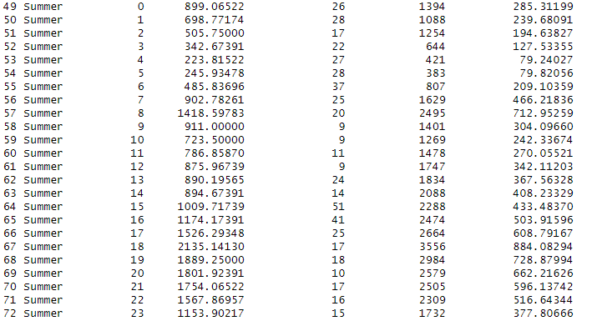
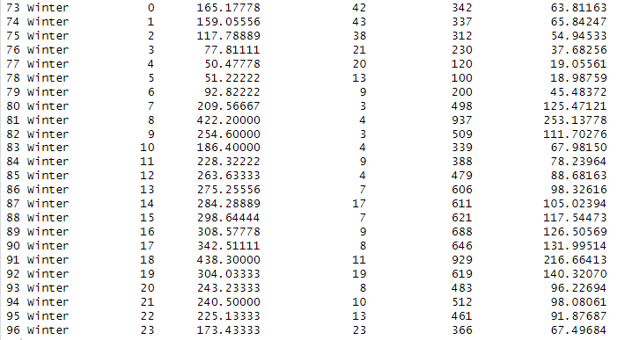
Rental seasonality for Summer and Winter

Slide 26
Weather Seasonality
Again, Summer has the highest average bike count value amidst all the weather variables consideration, as shown in the screenshot above

Slide 27
Bike-sharing info in Seoul
Seoul, a city in South Korea has a total of 20000 bikes, with a population of 21794000 people as outlined in the above screenshot

Slide 28
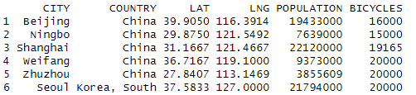
Cities similar to Seoul
Cities like Beijing, Ningbo, Shangai, Weifang, Zhuzhou can be compared to Seoul in terms of bicycles and population as shown in the screenshot

Slide 29
EDA with Visualization
In this section, the following visuals were created
A scatter plot of RENTED_BIKE_COUNT vs. DATE
A scatter plot of RENTED_BIKE_COUNT vs. DATETIME
Bike rental histogram with a kernel density curve
Boxplots of RENTED_BIKE_COUNT vs. HOUR grouped by SEASONS

Slide 30
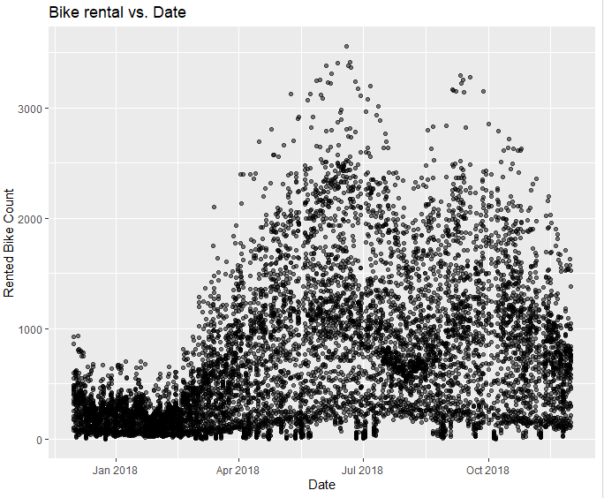
Bike rental vs. Date
In the earlier months of the year, the rental bike count is below 1000’s.
Immediately before April, the rental bike count shoots 3500, but it goes below that quantity for the rest of the year.

Slide 31
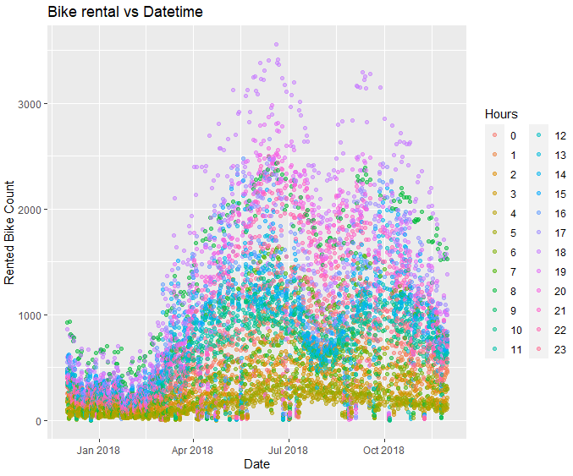
Bike rental vs. Datetime
In the earlier months of the year, the rental bike count is below 1000’s.
Immediately before April, the rental bike count shoots 3500, but it goes below that quantity for the rest of the year.
But this time, there is hour of the day incorporated within, but we notify that the morning and afternoon hours dominate

Slide 32
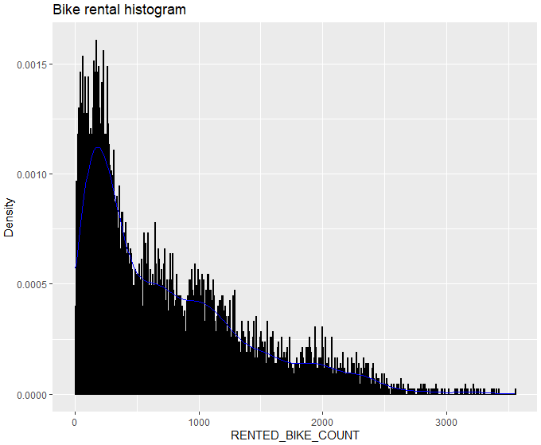
Bike rental histogram
From the screenshot, there is a very high density of Rented bike count below 500
The density goes on decreasing from 1000’s, to 2000’s and 3000’s having the least density of bike counts rented

Slide 33
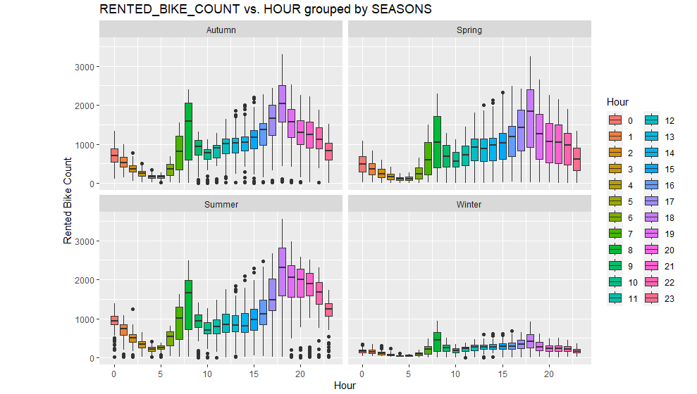
RENTED_BIKE_COUNT vs. HOUR grouped by SEASONS
Generally, summer has the highest number of rented bike count, followed by Autumn, spring and lastly the winter season
Winter and Autumn have a number of outliers more than other seasons below the lower extreme values
And as we can observe, all seasons have a few outliers above the upper extreme values

Slide 34
Predictive analysis
The following activities were carried out in this section:
Ranked coefficients
Model evaluation
Best performing model
Q-Q plot of the best model

Slide 35
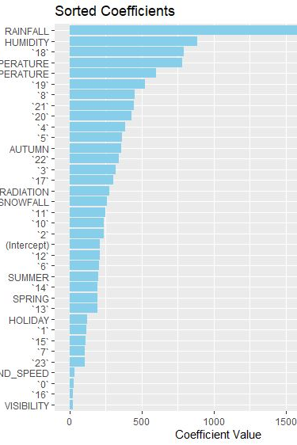
Ranked coefficients
Why some variables are important while some are not for predicting bike-sharing demand ?
Multicollinearity: When two or more independent variables are highly correlated, it can be difficult for the model to separate their individual effects. In such cases, one of the correlated variables may be dropped to reduce multicollinearity.
Overfitting: Including too many variables in a model can lead to overfitting.

Slide 36
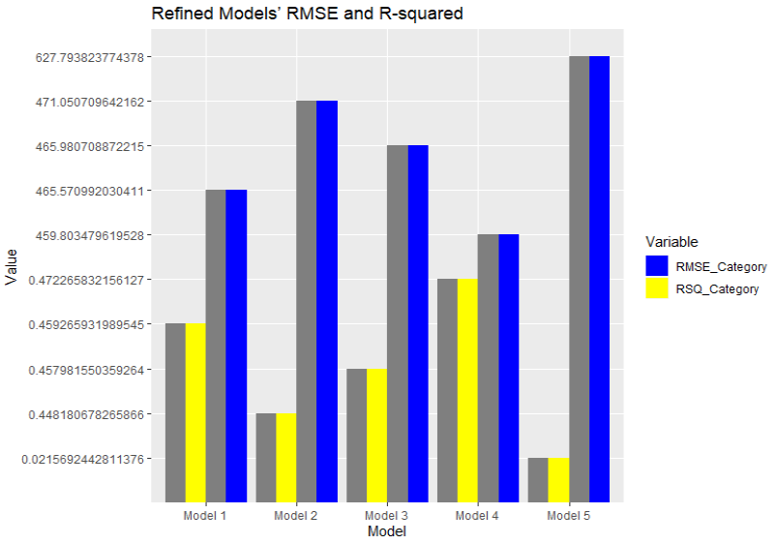
Model evaluation
Visual of the refined models’ RMSE and R-squared using grouped bar chart

Slide 37
Find the best performing model
interaction_term4 <- RAINFALL* HUMIDITY
RENTED_BIKE_COUNT ~ TEMPERATURE_poly + interaction_term4 * DEW_POINT_TEMPERATURE+ SOLAR_RADIATION *AUTUMN +SNOWFALL

Slide 38
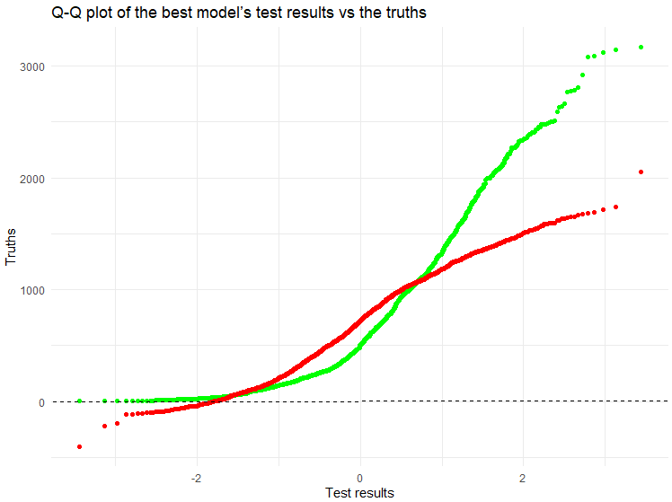
Q-Q plot of the best model

Slide 39
Dashboard
This section contains the following
Bike-sharing demand prediction app
Bike demand prediction in Paris
Bike demand prediction in Suzhou

Slide 40
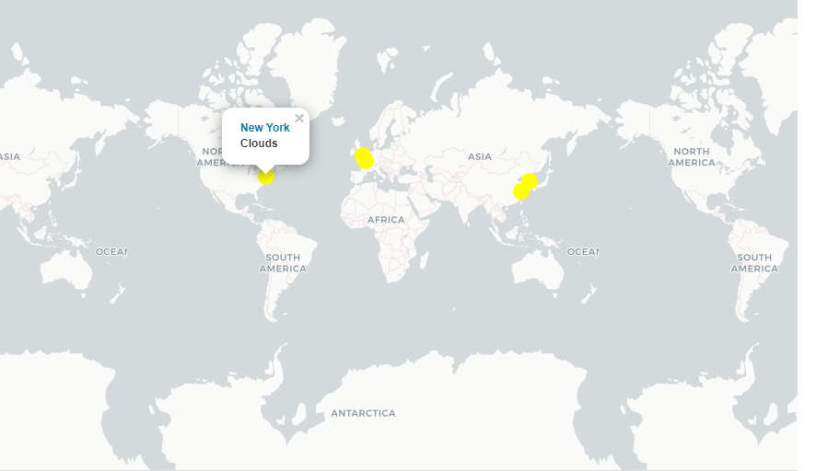
Bike-sharing demand prediction app
Cities’ max bike-sharing prediction on a map
A map to show which cities may have very large bike-sharing demand in the next 5 days

Slide 41
The important elements on the screenshot
A map shows which cities may have very large bike-sharing demand in the next 5 days
Circle markers with different sizes and colors, and popup labels on each city’s location indicate the number of rented bikes in different cities

Slide 42
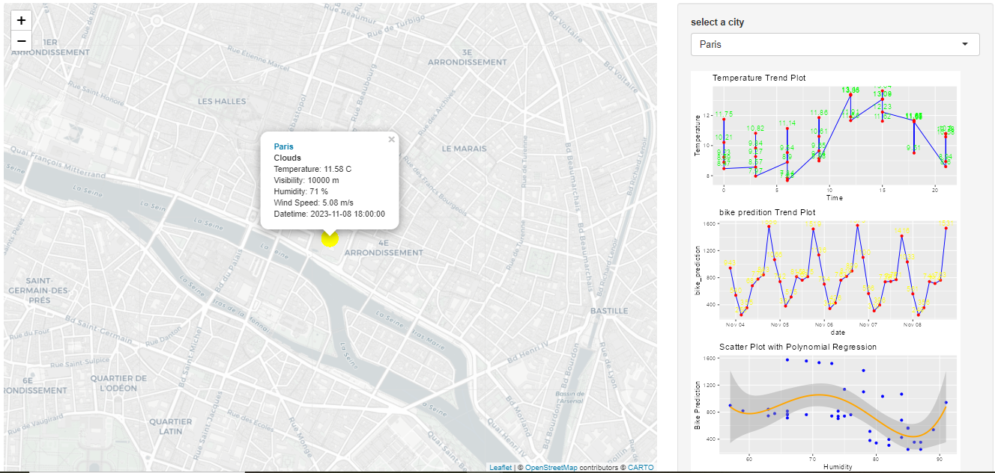
Bike demand prediction in Paris

Slide 43
The important elements on the screenshot
In Paris, it’s cloudy so the bike sharing count is medium
The days start off with low temperature but increase with after morning hours as shown on the temperature trend line curve
The other thing , there is a quadratic relationship between Bike prediction and humidity within this period, as observed from the scatter plot

Slide 44
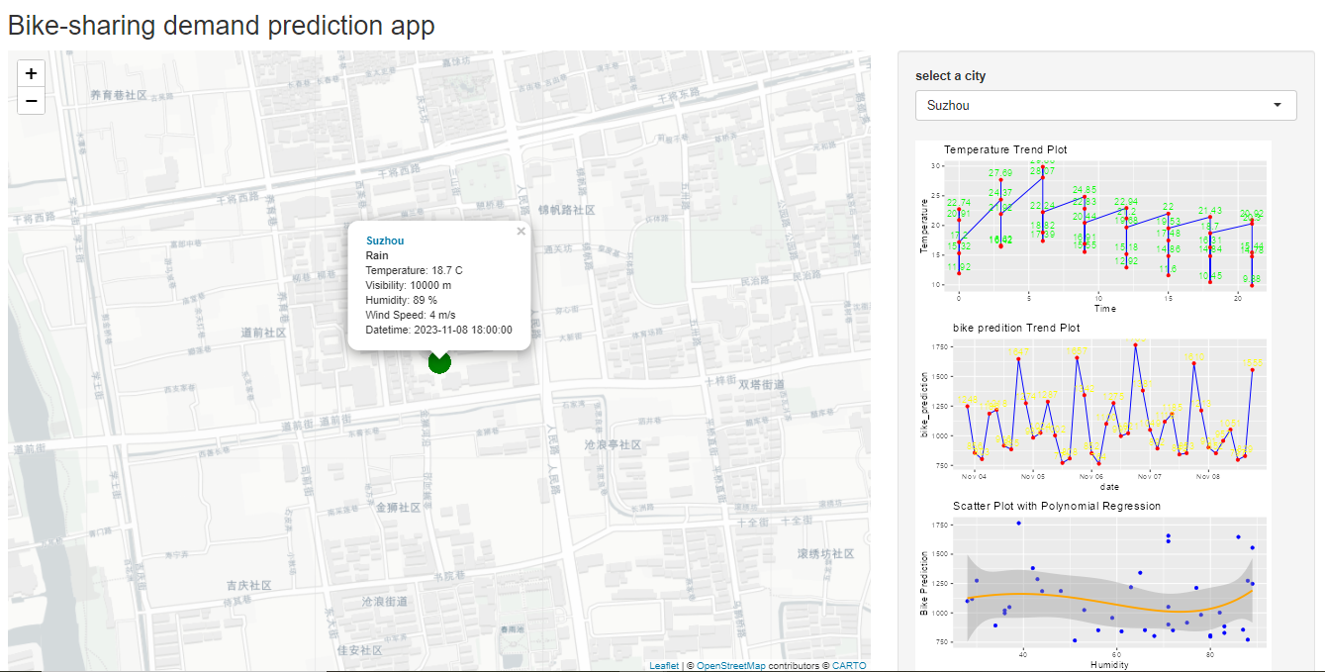
Bike demand prediction in Suzhou

Slide 45
The important elements on the screenshot
In Suzhou, it’s raining, so the bike count level is small
The period starts off with high temperatures but decrease after morning hours as shown on the temperature trend line curve
The other thing, there is almost no correlation between Bike prediction and humidity within this period, as observed from the scatter plot

Slide 46

CONCLUSION
Summer season has the least number of bike count rentals
Temperature has a positive correlation with the bike count rentals
Seoul of South Korea has the highest usage of bikes
The hour of 18 has the highest number of bikes rented

Slide 47

APPENDIX
This section contains relevant assets such R-code snippets, SQL queries and Notebook outputs

Slide 48
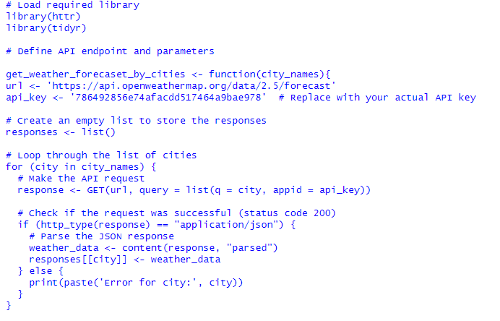
Code for OpenWeatherAPI

Slide 49
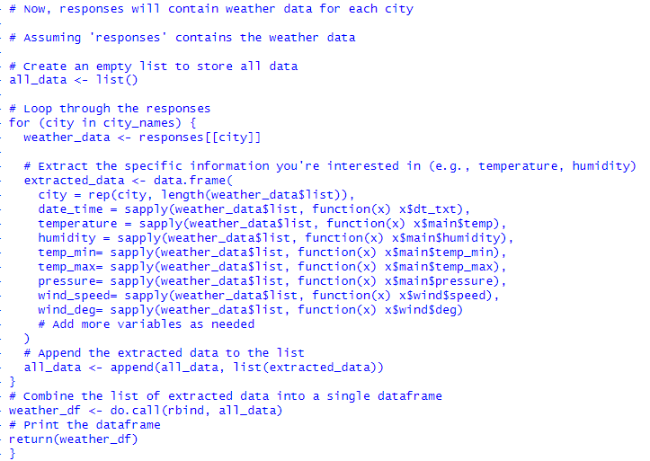
Code for OpenWeather API

Slide 50
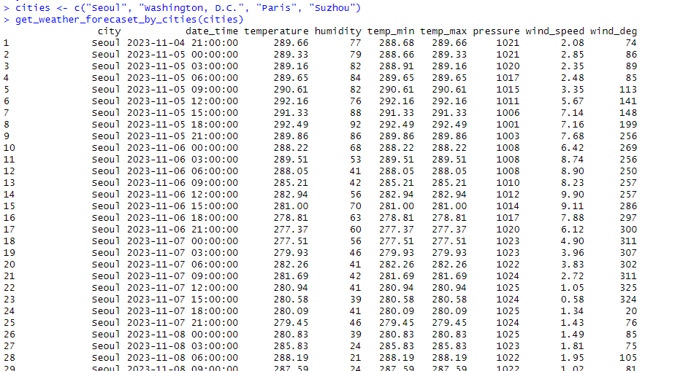
Output for OpenWeather API

Slide 51
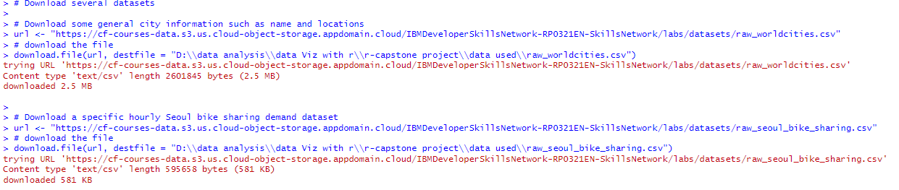
Web scraping some of the required datasets

Slide 52
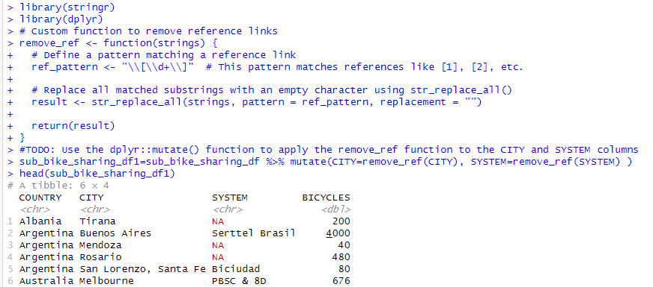
Data Wrangling Code And Output For Regular Expressions

Slide 53
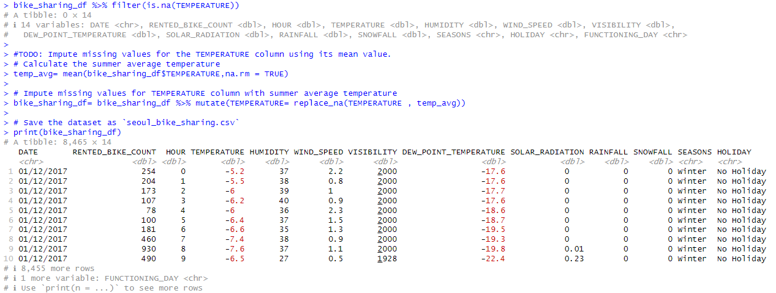
Missing Values Handling

Slide 54
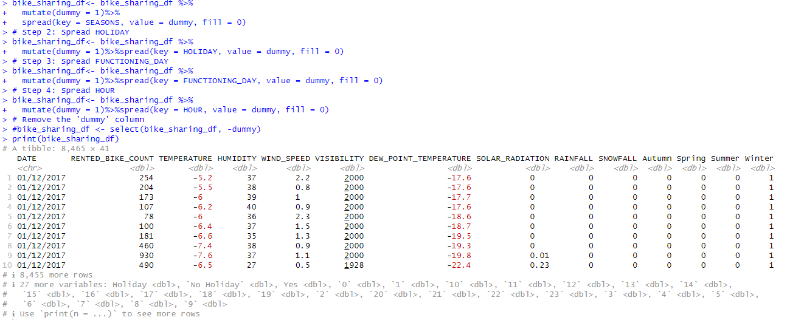
Generating Indicator Columns

Slide 55
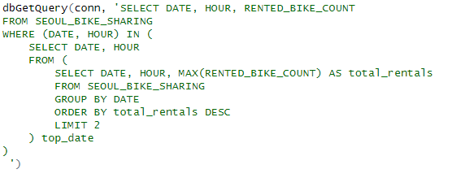
SQL-QUERIES: Busiest bike rental times

Slide 56
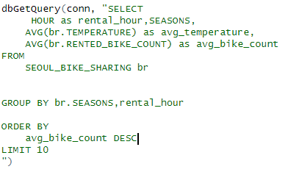
Hourly popularity and temperature by seasons

Slide 57
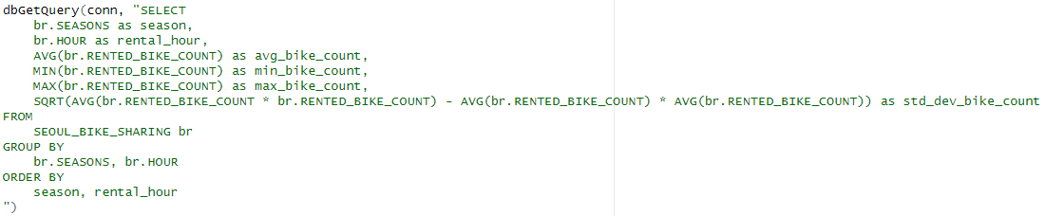
Rental Seasonality

Slide 58
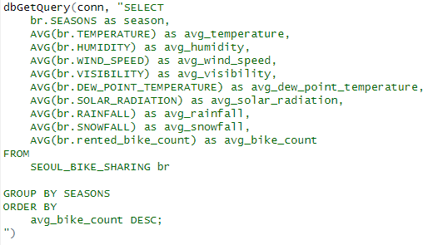
Weather Seasonality

Slide 59
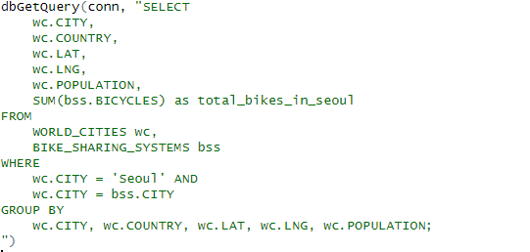
Bike-sharing info in Seoul

Slide 60
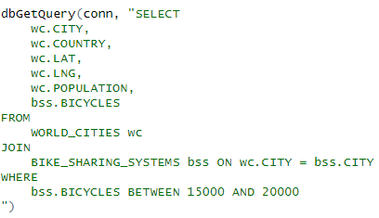
Cities similar to Seoul

Slide 61
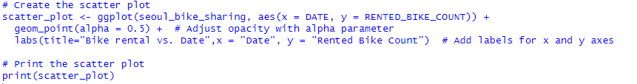
ggplot code snippets:Bike rental vs. Date

Slide 62
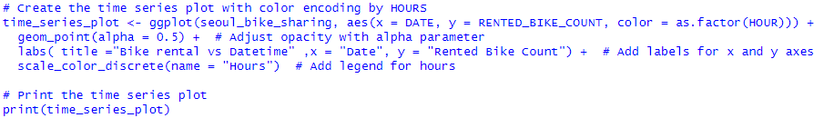
Bike rental vs. Datetime

Slide 63
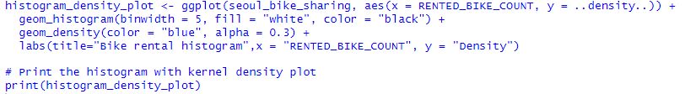
Bike rental histogram

Slide 64
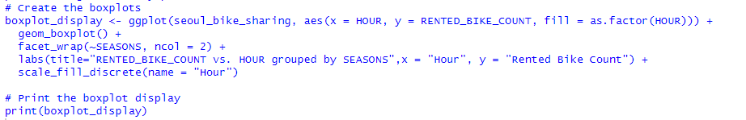
Boxplots of RENTED_BIKE_COUNT vs. HOUR grouped by SEASONS.

